Slide 1
DECODING BORROWER BEHAVIOR
A Data-Driven Exploration of Lending Patterns and Borrower Outcomes

Slide 2
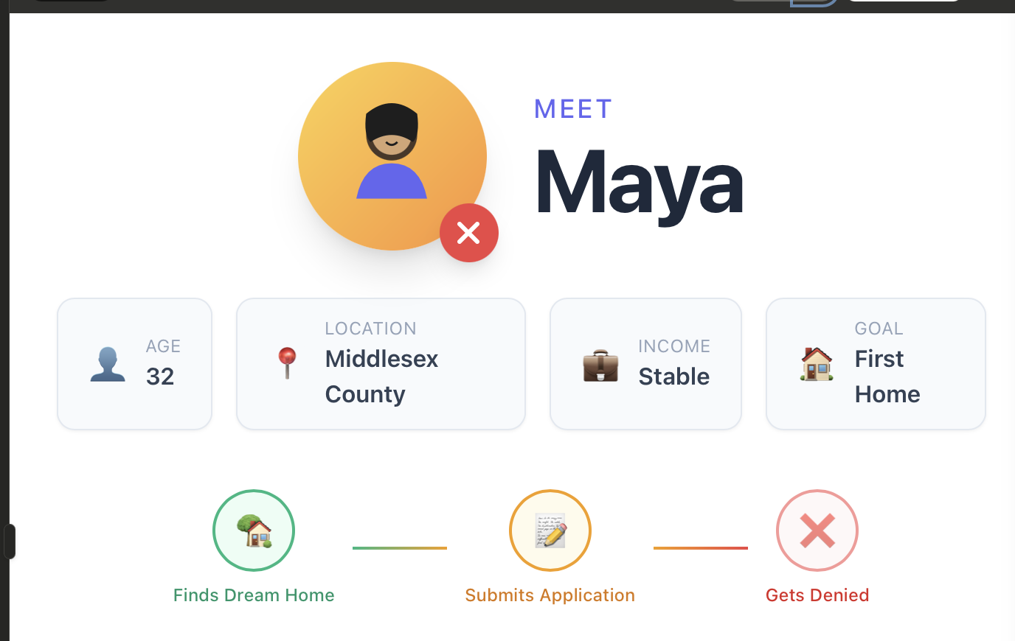
NO EXPLANATION. NO GUIDANCE. JUST A NO
If borrowers like Maya are denied despite decent income, what REALLY drives loan decisions in Massachusetts?
Who gets approved? Who gets denied? And Why?

Slide 3




PATH TO
LENDING
Understanding where the money flows
Exploring lending volume, loan types, and geographic distribution across Massachusetts
3 questions we answer
JHIOJ
How has lending volume changed over time?
Tracking application trends from 2020 to 2024
What types of loans dominate the market?
Conventional vs FHA vs VA breakdown
Where is lending concentrated?
County-level geographic patterns
Decoding borrower behavior

Slide 4



THE LENDING LANDSCAPE AT A GLANCE
1M
399k
750k
18%
Total Applications
Avg Loan Amount
Avg Property Value
Cashout Share
VOLUME
LOAN SIZE
PROPERTY
REFINANCE
5 years of MA mortgage data
Average financing per application
Average home value in dataset
Share of cash-out refinancing

Slide 5

Conventional loans dominate at 85%+
FHA & VA serve niche borrower segments
Boston metro dominates: Middlesex & Suffolk
counties lead in application volume
2021 refinancing boom: 200K+ applications
driven by historic low interest rates

Slide 6
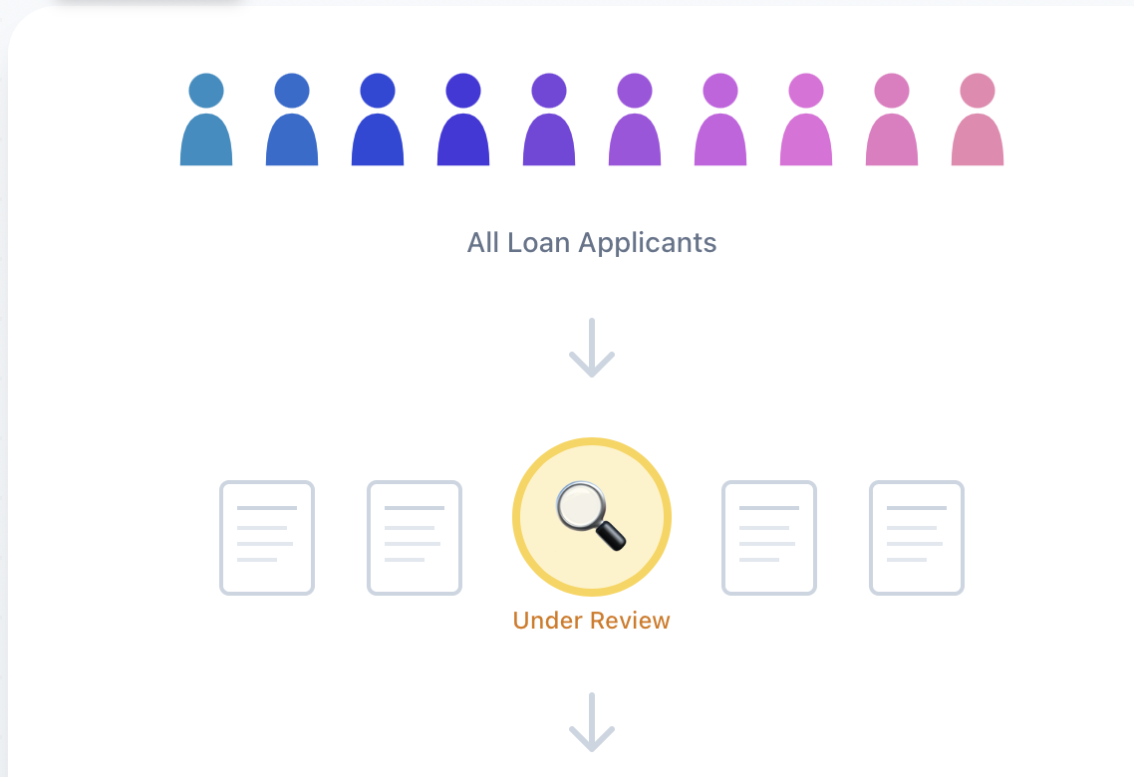

NOW THAT WE KNOW WHERE THE MONEY GOES...
Who actually gets approved?

Slide 7
PATH TO
APPROVAL
Discovering what makes dreams come true
Understanding what drives successful loan applications across Massachusetts
3 questions we answer
 | What is the overall approval rate?
 | Success metrics across all applications
 | What factors drive loan approval?
 | Key influencers that boost your chances
 | Which demographics succeed?
 | Age groups & income patterns

Slide 8









LOW DTI
Debt-to-Income Decrease DTI By 12.46 Points For Maximum Impact
Approval Boost 1.22x
LOW RISK
Risk Flags Maintain risk flags between 0-1 range
Approval Boost 1.18x
PURCHASE
Loan Purpose Home purchase beats refinancing applications
Approval Boost 1.16x
LTV RATIO
Loan-to-Value Target optimal 79-80% LTV range
Approval Boost 1.13x
#1 FACTOR
HIGH IMPACT
STRONG
MODERATE
Key Insight As DTI ratio decreases, approval likelihood increases linearly,
keeping DTI below 43% is the single strongest predictor of loan success!
66% variance is explained

Slide 9
PRIMARY GOALS
Home purchases cluster high on loan amount regardless of income, while refinancing spreads wide.
Approval rates fell from 65.69% (2020) to 54.95% (2023) — a direct casualty of rising interest rates
→
ANNUAL REVENUE GROWTH
Ages 35-44 consistently lead approvals across all years, but the 25-34 cohort is rapidly closing the gap

Slide 10

NOW THAT WE KNOW WHO GETS DENIED...
Why do some applications get denied?

Slide 11



PATH TO DENIAL
Which loan purposes face the highest denial rates?
How do denial rates vary across income groups?
What factors ultimately lead to a loan being denied?
Because understanding purpose-level risk shows where borrowers experience the most friction.
Because income level is one of the strongest predictors of loan denial
Because identifying key denial drivers helps explain lender decision-making

Slide 12
AREAS OF GROWTH
 | B2B | Supply chain | ROI | E-commerce
Q1 | 4.5 | 2.3 | 1.7 | 5.0
Q2 | 3.2 | 5.1 | 4.4 | 3.0
Q3 | 2.1 | 1.7 | 2.5 | 2.8
Q4 | 4.5 | 2.2 | 1.7 | 70

Slide 13

WHAT THE DATA REVEALS ABOUT LOAN DENIAL
~11%
~14%
~29%
~60%
DENIAL TRENDS
INCOME IMPACT
LOAN PURPOSE
DENIAL DRIVER
Denial rates remain stable across the four years, showing consistent lender behavior despite large swings in total applications.
Applicants earning under $50k are significantly more likely to be denied compared to higher-income groups.
Home improvement loans face the highest denial rates, showing greater borrower friction in this category.
Debt-to-income ratio and credit history emerge as the strongest predictors of loan denial across all borrower groups.

Slide 14





Recommendations
Turning insights into action
For Lenders
→ Alternative home improvement product
→ DTI counseling & pre-qualification programs
For Policy
→ Fund literacy programs for <$50K earners
→ Expand first-time buyer assistance
For Borrowers
→ Target 20%+ down payment
→ Build credit score above 680
Future Research
→ Deep-dive demographic disparities
→ Predictive approval modeling

Slide 15
“
Numbers have an important story to tell. They rely on you to give them a voice.
”
Stephen Few

Slide 16

THANK YOU
GROUP 8

